Slide 1




The Department of Children, Disability and Equality
2026 Research
Findings
Households with
Children under 18
May 2026
S26-035

Slide 2
Background to 2026 Survey of Parents/Guardians
In 2020 Amárach Research undertook an online survey of households with children under the age of 18 for The Department of Children, Disability and Equality (DCDE). The research was in preparation of the DCDE’s parenting model and covered areas such as:
  Children & family structure
  Parenting supports & services
  Information & advice
  Areas of support
A follow-up wave of research was commissioned in 2024, to provide comparisons and benchmark the research while also including new areas of focus, including detail on specific supports required, and feedback on what it is like to be a parent.
For this 2026 wave, the questionnaire was once again designed in collaboration with DCDE and stakeholder groups. The survey was largely kept the same as in 2024, with some updating and expanding of existing questions and response options.
An online survey of N = 1,000 parents/guardians was undertaken from the 21st April to the 5th May 2026.
This report provides a summary of results, using the 2026 total sample of N = 1,000 parents/guardians as its anchor point. A 2026 sub sample of N = 197 minority ethnic participants is reported alongside the total sample, from which this sub sample was extracted.
Comparative results for 2020 and 2024 are shown where applicable. It should be noted when making comparisons, the 2020 research was carried out during an exceptional period, during the first year of the COVID-19 pandemic.
This wave included an additional link circulated to harder to reach parent groups, including Traveller representative organisations, a DEIS programme rep, FRCs and Family Link Workers.
Please note: There are some variations within code lists between 2020 and 2024 and 2026. The questions where this applies are noted within the report.
Single code question data totalling +/- 100% is the result of rounding.

Slide 3
2026 Sample Overview
The sample surveyed for this third wave of research represents a population of households with children aged under 18, with quotas and subsequent weighting applied to reflect the population spread on Age of Child in Household, Region and Household Composition (CSO 2022).
Within the total sample of N = 1,000 adults, various parental sub samples are also reported and compared with the nat. rep. result for context:
  Minority ethnic: N = 197
  One parent households: N = 181
  Key demographic groups – gender, age, social class and region
This is a survey of adults living in households with children under the age of 18, identified via the opening question:
  Are you Mother/Father/Guardian/Kinship carer of the children in your home?
The demographics of the research participants has a female/mother focus
  67% females, and 33% males, with the majority falling into the age ranges from 25 to 54 years.
  63% are in ABC1F50+ (higher) social grade households, 37% in C2DEF<50 (lower) social grade households.
Single or separated parents are robustly represented in the sample: 24%.
The sample is spread nationally, and 21% of the sample are rurally based, 36% city based, and the balance live in an urban or suburban area.
6% speak a language other than English or Irish at home most often.
18% identify with a nationality other than Irish and 21% identify with an ethnic group other than Irish.
Minority ethnic parents total N = 197 overall, 20% of the sample.

Slide 4
2026 Findings Overview
Stress is widespread among parents and guardians. 41% feel worry or stress in their parenting role often or most of the time, in line with 2024, with the heaviest load falling on parents aged 18–34 and those parenting alone. 28% say they regularly need advice or support, rising to 42% for 18–34s.
Personal networks are crucial. Family, friends, GPs and online searches remain the main sources of parenting advice, the same top three across all three waves. Awareness of local supports has climbed sharply: only 20% are unaware of any local service, down from 56% in 2020. Parent & toddler groups, breastfeeding support groups and antenatal classes top the awareness list.
Overall, perceptions of national support have improved. 44% say parents get only some or not a lot of information and support in Ireland, a 10-point decrease compared to 2024. Half (52%) of those using services say their needs were met, up 5 points over the same period.
Behaviour, anxiety and child development are the leading issues parents want help with. 17% report a child with a disability or additional needs, with Autism the most common diagnosis at 53%, up from 39% in 2024.
Online channels continue to be preferred. 55% favour websites as a delivery channel (+9 points), and Mychild.ie, Gov.ie and social media remain the most-used platforms. Community centres and schools remain the preferred in-person settings.
Love and connection are described by parents as being the most rewarding part of the role, while balancing work and family is felt to be the hardest.

Slide 5
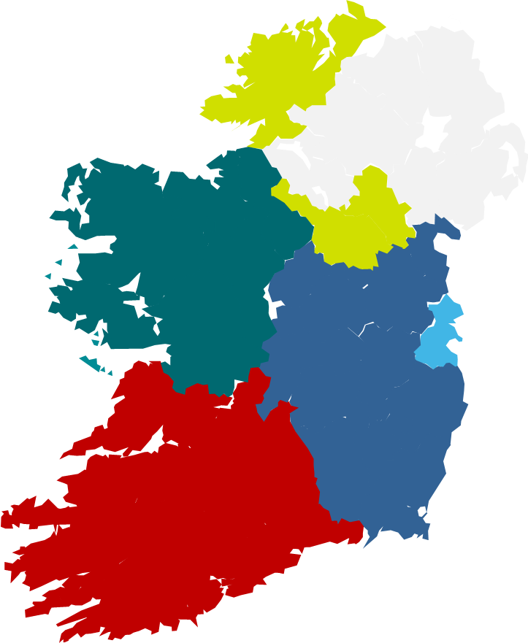








Total Sample (N = 1,000): Sample profile 2026 – I
Gender
Social Class
Region
Relationship
33%
67%
37%
Lower Social Grades
Conn/ Ulster
18%
63%
Higher Social Grades
Rest of
Leinster
29%
Dublin 26%
Mother
Munster
27%
Age
Area
Countryside
21%
Small town
28%
Father
City or large town
36%
Suburbs
15%
Guardian
Kinship carer
*

Slide 6




Total Sample (N = 1,000): Sample profile 2026 – II
Household Structure
Language
Nationality
Ethnic Group
24%

Slide 7
Minority Ethnic Sample (N = 197): Sample profile 2026 – I
Gender
Social Class
Region
Relationship
29%
71%
37%
Lower Social Grades
Conn/ Ulster
22%
63%
Higher Social Grades
Rest of
Leinster
33%
Dublin 30%
Mother
Munster
15%
Age
Area
Countryside
13%
Small town
37%
Father
City or large town
38%
Suburbs
12%
Guardian
Kinship carer

Slide 8
Minority Ethnic Sample (N = 197): Sample profile 2026 – II
Household Structure
Language
Nationality
Ethnic Group
15%

Slide 9

School Stage & Age Groups

Slide 10
School Stage / Age Ranges
(Base: Mother/Father/Guardian/Kinship carer of the children in your home)
TOTAL SAMPLE
2024
N=1,000
2026
N=1,000
Pre School
Primary School
Secondary School
New Question in 2024
Q4 How many children do you have in each of the following school stages? - Any

Slide 11
Age of Children
(Base: Mother/Father/Guardian/Kinship carer of the children in your home)
TOTAL SAMPLE
2020
N=911
2024
N=1,000
2026
N=1,000
Under 2 years
2 to 5 years
6 to 12 years
13 to 17 years
Q5 Have children in these age ranges:

Slide 12
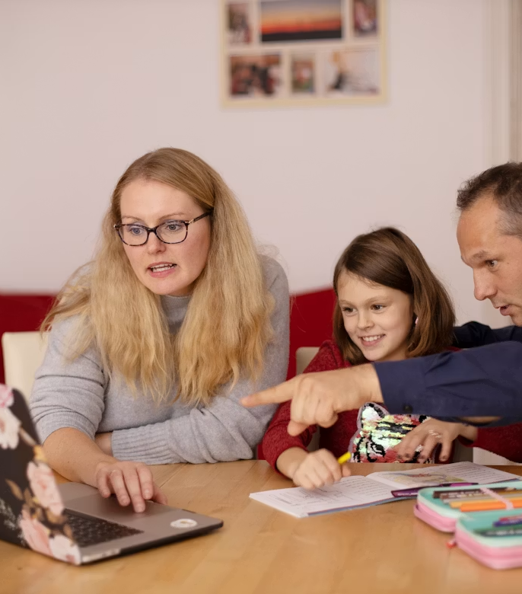
Advice and Supports

Slide 13
Two-fifths (41%) report feelings of worry or stress in relation to parenting, either often or most of the time. This has remained relatively consistent across each wave of research.
(Base: All respondents)
TOTAL SAMPLE
2020
N=911
2024
N=1,000
2026
N=1,000
Most of the time
40%
43%
41%
Often
 |  | GENDER |  |  |  |  |  | CLASS |  | REGION |  |  |  | HOUSEHOLD
 | TOTAL | Male | Female | 18-34 | 35-44 | 45-54 | 55+** | ABC1 F50+ | C2DE F50- | Dublin | Leinster (excl Dublin) | Munster | Conn/ Ulster | Couple Children/others | One parent children/others
2026
N= | 1000 | 331 | 669 | 251 | 421 | 286 | 42 | 644 | 356 | 260 | 290 | 270 | 180 | 760 | 240
Most – Often | 41% | 32% | 44% | 52% | 43% | 25% | 35% | 40% | 42% | 38% | 44% | 41% | 36% | 38% | 47%
Sometimes | 42% | 45% | 41% | 37% | 40% | 50% | 44% | 44% | 40% | 47% | 39% | 39% | 47% | 44% | 37%
Rarely – Never | 17% | 23% | 15% | 11% | 16% | 24% | 20% | 17% | 19% | 15% | 17% | 20% | 17% | 18% | 16%
Sometimes
Rarely
Never
** Caution small base size
Q11 In general, how often do you feel worry or stress in relation to parenting?

Slide 14
Three in ten (28%) feel they need advice or support in relation to parenting, often or most of the time - also consistent with the previous wave results.
(Base: All respondents)
TOTAL SAMPLE
2024
N=1,000
2026
N=1,000
Most of the time
29%
28%
Often
 |  | GENDER |  |  |  |  |  | CLASS |  | REGION |  |  |  | HOUSEHOLD
 | TOTAL | Male | Female | 18-34 | 35-44 | 45-54 | 55+** | ABC1 F50+ | C2DE F50- | Dublin | Leinster (excl Dublin) | Munster | Conn/ Ulster | Couple Children/others | One parent children/others
2026
N= | 1000 | 331 | 669 | 251 | 421 | 286 | 42 | 644 | 356 | 260 | 290 | 270 | 180 | 760 | 240
Most – Often | 28% | 26% | 29% | 42% | 30% | 14% | 19% | 29% | 27% | 34% | 23% | 24% | 34% | 26% | 35%
Sometimes | 46% | 44% | 46% | 44% | 45% | 49% | 36% | 47% | 42% | 45% | 49% | 47% | 38% | 47% | 43%
Rarely – Never | 26% | 30% | 24% | 14% | 25% | 36% | 45% | 24% | 31% | 21% | 28% | 29% | 28% | 28% | 23%
Sometimes
Rarely
Never
New Question in 2024
** Caution small base size
Q10 How often have you felt that you needed advice or support in relation to parenting?

Slide 15
Family/Friends, GP*, and Online search remain the top three sources for parenting advice in 2026 for the total sample of respondents.
(Base: All respondents)
TOTAL SAMPLE
2020
N=907
2024
N=1,000
2026
N=981
1st mention
Top 3
1st mention
Top 3
1st mention
Top 3
*2020 codes differ from 2024, 2026
Q12 Who/where do you go to for advice or support about parenting?

Slide 16
Parent and toddler groups, Breastfeeding support groups and Antenatal classes rank highest for awareness regarding parenting supports in the local community, with similar results seen in 2024.
(Base: All respondents)
TOTAL SAMPLE
2020
N=911
2024
N=1,000
2026
N=1,000
Q13 What parenting supports are you aware of in your local community or area?

Slide 17
Family/friends, Online search, and GP are the top resources used to find out about parenting support services in the local area, on par with the previous wave.
(Base: All respondents)
TOTAL SAMPLE
2020 Sample
N=404
2024 Sample
N=1,000
2026
N=1,000
*2020 codes differ from 2024, 2026
Q14 How do you find out about parenting support services in your area?

Slide 18
Overall, over two in five (44%) feel parents get some/not a lot of information & support for their parenting role in Ireland, and while a 10 pt drop compared to last wave, it stands at 50% for females.
(Base: All respondents)
MAIN SAMPLE
Information and Support
2020
N=911
2024
N=1,000
2026
N=1,000
A great deal
Above average
A great deal
16%
A great deal
16%
A great deal
21%
 |  | GENDER |  |  |  |  |  | CLASS |  | REGION |  |  |  | HOUSEHOLD
 | TOTAL | Male | Female | 18-34 | 35-44 | 45-54 | 55+** | ABC1 F50+ | C2DE F50- | Dublin | Leinster (excl Dublin) | Munster | Conn/ Ulster | Couple Children/others | One parent children/others
2026
N= | 1000 | 331 | 669 | 251 | 421 | 286 | 42 | 644 | 356 | 260 | 290 | 270 | 180 | 760 | 240
A great deal | 21% | 31% | 16% | 30% | 17% | 20% | 20% | 20% | 23% | 30% | 17% | 18% | 18% | 24% | 13%
Average | 35% | 38% | 34% | 32% | 39% | 33% | 29% | 36% | 34% | 32% | 38% | 32% | 40% | 34% | 38%
Not a lot/some | 44% | 31% | 50% | 38% | 44% | 47% | 51% | 44% | 43% | 38% | 45% | 49% | 42% | 42% | 49%
Average
Some
Some/not a lot
51%
Some/not a lot
54%
Some/not a lot
44%
Not a lot
** Caution small base size
Q15 How much information & support do you think parents get for their parenting role, in Ireland?

Slide 19

Child whose birthday is next
Questions to focus on specific child needs

Slide 20
Age and Gender of child whose birthday is next
AGE
GENDER
2020 Sample
N=911
2024 Sample
N=1,000
2026 Sample
N=1,000
2020 Sample
N=911
2024 Sample
N=1,000
2026 Sample
N=1,000
Under 2 years
2 to 5 years
Male
6 to 12 years
Female
13 to 17 years
Prefer not to say
Q16 Could you please give their current age, if they are less than a year please enter '0’.
Q17 What is their gender?

Slide 21
Autism remains the most common disability among children under 18.
(Base: Have a disability or any additional support needs)
TOTAL SAMPLE
2024
N=139
2026
N=174
Yes = 14%
Yes = 17%
Open question in 2024
New Question in 2024
Q18 Does your child whose birthday is next have a disability or any additional support needs?

Slide 22

Key Parenting Issues and Services Used

Slide 23
Behaviour, Anxiety and Child development are reported as the top three parenting issues where information, advice or support is sought.
(Base: All respondents)
TOTAL SAMPLE
2020 Sample
N=905
2024 Sample
N=1,000
2026
N=931
1st mention
Top 3
1st mention
Top 3
1st mention
Top 3
*Codes changed over each wave
Q19 In the last 6 months, what are the key parenting issues that you have wanted information, advice or support on? (ref: child whose birthday is next).

Slide 24
Antenatal classes, Parent & toddler groups, and Parent support groups are the supports most attended in 2026.
(Base: All respondents)
TOTAL SAMPLE
2020
N=911
2024
N=1,000
2026
N=1,000
*Codes changed over each wave
Q20 Which parenting supports have you ever used or attended for your child whose birthday is next?

Slide 25
Three in ten (30%) report that their partner/co-parent used parenting supports in 2026, in line with 2024 levels.
(Base: All respondents)
Partner/Co-parent used any
parenting supports
TOTAL SAMPLE
2020 Sample
N=911
2024 Sample
N=1,000
2026
N=1,000
*NA/DK excluded
Q21 Has your partner/co-parent used any parenting supports in relation to your child whose birthday is next?

Slide 26
Just over half (52%) agree the supports/services they have used have met their needs (+5% pts versus 2024).
(Base: All respondents)
Supports/Services have met my needs
2020
N=911
2024
N=1,000
2026
N=1,000
Strongly agree
 |  | GENDER |  |  |  |  |  | CLASS |  | REGION |  |  |  | HOUSEHOLD
 | TOTAL | Male | Female | 18-34 | 35-44 | 45-54 | 55+** | ABC1 F50+ | C2DE F50- | Dublin | Leinster (excl Dublin) | Munster | Conn/ Ulster | Couple Children/others | One parent children/others
2026
N= | 1000 | 331 | 669 | 251 | 421 | 286 | 42 | 644 | 356 | 260 | 290 | 270 | 180 | 760 | 240
Agree | 52% | 59% | 49% | 60% | 51% | 48% | 45% | 54% | 49% | 59% | 51% | 41% | 61% | 53% | 49%
Unsure | 18% | 18% | 18% | 21% | 17% | 16% | 23% | 16% | 21% | 19% | 21% | 17% | 13% | 16% | 23%
Disagree | 13% | 7% | 15% | 9% | 16% | 11% | 14% | 12% | 13% | 11% | 8% | 19% | 11% | 12% | 16%
Agree
33%
Agree
Agree
47%
Agree
52%
Unsure*
Disagree
Disagree
13%
Strongly disagree
Disagree
14%
Disagree
13%
Not applicable
*2020 included ‘undecided’ instead of ‘Unsure’ in survey
** Caution small base size
Q22 How much do you agree or disagree with this statement in relation to your child whose birthday is next:
The supports/services I have used have met my needs.

Slide 27
A lack of need or awareness of parenting supports and inconvenient/lack of time are the top reasons for not using parenting support services in 2026 – with similar results seen last wave.
(Base: All respondents)
Reason you might not use
a parenting support service
TOTAL SAMPLE
2020
N=911
2024
N=1,000
2026
N=1,000
*2020 codes differ from 2024, 2026
Q23 Is there any reason why you might not choose to use a parenting support service in relation to your child whose birthday is next?

Slide 28
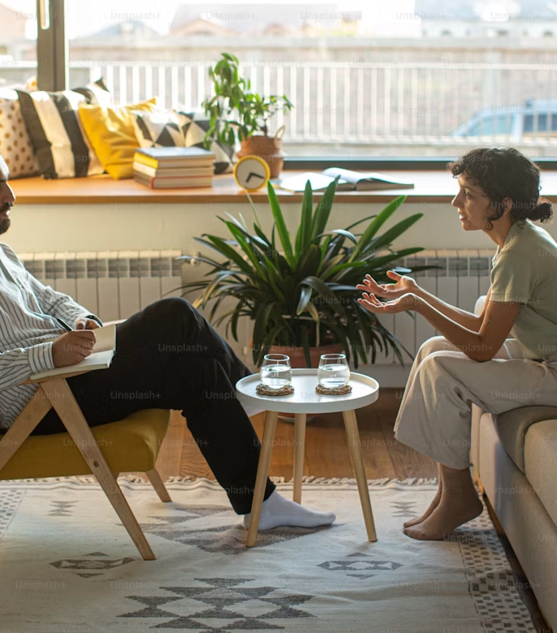
Delivery and Focus of Parenting Supports

Slide 29
Websites, face-to-face group-based and individual supports remain the preferred forms of delivery of parenting supports. Interest in parenting supports via websites increased by 9%pts this wave (first mention).
(Base: All respondents)
TOTAL SAMPLE
2020
N=908
2024
N=1,000
2026
N=959
*2020 codes differ from 2024, 2026
Q24 What is your preference for the delivery of parenting supports in relation to your child whose birthday is next?

Slide 30
Community centre and School are the top preferences for in-person parenting information and support in 2026 - consistent across both the main sample and Minority Ethnic sample.
(Base: All respondents)
TOTAL SAMPLE
2024
N=1,000
2026
N=1,000
New Question in 2024
Q25 Which place(s) would you like to go for in-person parenting information and support for your child whose birthday is next?

Slide 31
Mychild.ie, Gov.ie, and various social media sites remain the top websites/platforms used for parenting advice and support in 2026.
(Base: All respondents)
TOTAL SAMPLE
2020
N=911
2024
N=1,000
2026
N=1,000
*Codes changed over each wave
Q26 Which of the following websites/platforms, if any have you used for parenting advice and support in relation to your child whose birthday is next?

Slide 32
Information about child development is reported as the most helpful aspect of using websites for parenting advice.
(Base: All respondents)
TOTAL SAMPLE
2020
N=911
2024
N=1,000
2026
N=1,000
Q27 If you use websites for parenting advice, what aspects of them have you found helpful in relation to your child whose birthday is next?

Slide 33
Love and Connection continues to be reported as the most rewarding aspect about being a parent.
(Base: All respondents)
TOTAL SAMPLE
2024
N=1,000
2026
N=1,000
Open question in 2024
New Question in 2024
Q28 What do you find most rewarding about being a parent? (Spontaneous responses to open question - coded)

Slide 34
While Balancing work and family is highlighted as the most challenging aspect of parenting in 2026.
(Base: All respondents)
TOTAL SAMPLE
2024
N=1,000
2026
N=1,000
Open question in 2024
New Question in 2024
Q29 What do you find most challenging about being a parent? (Spontaneous responses to open question - coded)

Slide 35
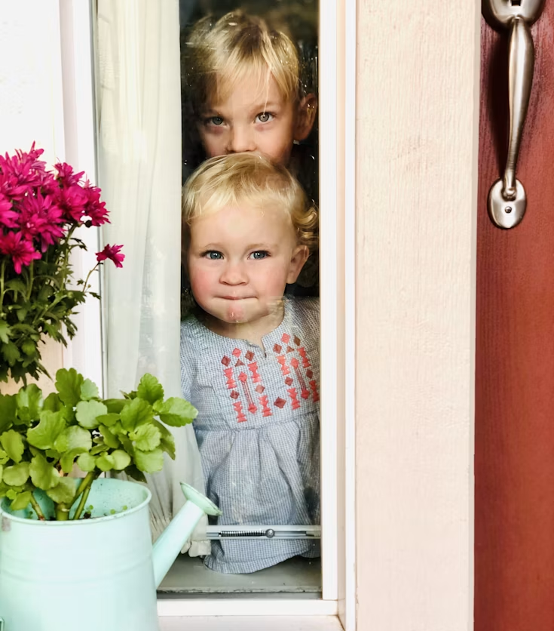
Key Findings

Slide 36
KEY FINDINGS
Advice and Supports
41% report feelings of worry or stress in relation to parenting, either often or most of the time. This has remained relatively consistent across each wave of research.
  Those aged 18-34 and those who are parenting alone are most likely to feel worry or stress often/most of the time.
28% feel they need advice or support in relation to parenting, often or most of the time - also consistent with the previous wave results.
  Those aged 18-34 and single parents are most likely to report this.
Family/Friends, GP, and Online search are the top three sources for parenting advice in 2026 for both the total sample and Minority Ethnic sample.
In terms of awareness of parenting supports available locally, parent and toddler groups, breastfeeding support groups and antenatal classes rank highest – on par with the 2024 wave of research. For the Minority Ethnic sample, breastfeeding support groups, parent and toddler groups and parent support groups rank top.
The most popular means of finding out about local support services for both samples are family and friends, online searches, and a GP.
Overall, 44% feel parents get some/not a lot of information & support for their parenting role in Ireland - a decrease of 10%pts versus 2024.

Slide 37
KEY FINDINGS
Key Parenting Issues and Services Used
Among the main sample, 17% report their child having a disability, with Autism being the most common at 53% (versus 39% in 2024). Among the Minority Ethnic sample, 12% report their child having a disability or additional needs, with Autism also being the most common at 61%.
Over the last 6 months, the key parenting issues for which advice has been sought has been behaviour, anxiety, and child development. For the Minority Ethnic sample, behaviour, child development and education rank highest.
The parenting support groups reported to have been attended most in 2026 are antenatal, parent & toddler, and parent support groups. Among the main sample, 30% of partners/co-parents have used parenting supports, rising to 34% for the Minority Ethnic Sample.
Over half of the main sample (52%) either strongly agree or agree that the supports/services they have used have met their needs – up 5% pts since 2024.
Apart from not needing any additional support, a lack of awareness of parenting supports and inconvenient/lack of time are the top reasons for not using parenting support services in 2026. This is consistent with the previous wave of research.

Slide 38
KEY FINDINGS
Delivery and Focus of Parenting Supports
When asked about their preference for delivery of parenting supports, websites remains the clear favourite among both the main sample and the Minority Ethnic sample. This preference increased further this wave (+9% pts for main sample; +7%pts for Minority Ethnic sample). Individual and group face to face also ranks highly for both samples.
Regarding preferred places to go for in person information and support, community centres and schools top the list across both samples, consistent with the previous wave of research.
When asked about sources used for advice and support, Mychild.ie, Gov.ie, and various social media sites remain the top websites/platforms used in 2026 across both samples, though all have decreased in use since the previous wave.
Information about child development is the parenting topic where more information would be welcomed across both the main and Minority Ethnic Sample.
Love and Connection continues to be reported as the most rewarding aspect about being a parent in 2026 while balancing work and family is the most challenging part.

Slide 39

APPENDIX

Slide 40
School Stage / Age Ranges
(Base: Mother/Father/Guardian/Kinship carer of the children in your home)
TOTAL SAMPLE
MINORITY ETHNIC SAMPLE
2024
N=1,000
2026
N=1,000
2024
N=380
2026
N=197
Pre School
Pre School
Primary School
Primary School
Secondary School
Secondary School
New Question in 2024
Q4 How many children do you have in each of the following school stages? - Any

Slide 41
Age of Children
(Base: Mother/Father/Guardian/Kinship carer of the children in your home)
TOTAL SAMPLE
MINORITY ETHNIC SAMPLE
2020
N=911
2024
N=1,000
2026
N=1,000
2024
N=380
2026
N=197
Under 2 years
Under 2 years
2 to 5 years
2 to 5 years
6 to 12 years
6 to 12 years
13 to 17 years
13 to 17 years
Q5 Have children in these age ranges:

Slide 42
…with the same top 3 appearing for the Minority Ethnic sample.
(Base: All respondents)
MINORITY ETHNIC SAMPLE
2024
N=380
2026
N=192
1st mention
Top 3
1st mention
Top 3
Q12 Who/where do you go to for advice or support about parenting?

Slide 43
Advice or support about parenting – Top 3
Demographics
(Base: All respondents)
 |  | GENDER |  |  |  |  |  | CLASS |  | REGION |  |  |  | HOUSEHOLD
TOP 3 2026 | TOTAL | Male | Female | 18-34 | 35-44 | 45-54 | 55+** | ABC1 F50+ | C2DE F50- | Dublin | Leinster (excl Dublin) | Munster | Conn/ Ulster | Couple Children/others | One parent children/others
MAIN SAMPLE
N= | 981 | 324 | 657 | 248 | 413 | 280 | 41 | 634 | 347 | 256 | 285 | 266 | 174 | 742 | 239
Family/Friends | 87% | 86% | 88% | 89% | 86% | 87% | 95% | 87% | 88% | 86% | 90% | 88% | 85% | 86% | 93%
GP | 45% | 40% | 48% | 41% | 48% | 44% | 48% | 42% | 52% | 46% | 47% | 43% | 46% | 44% | 51%
Online search | 39% | 36% | 41% | 28% | 41% | 46% | 42% | 43% | 33% | 35% | 41% | 44% | 36% | 42% | 32%
ETHNIC MINORITY
N= | 192 | 55 | 137 | 57 | 97 | 30 | 8 | 121 | 71 | 58 | 64 | 28 | 42 | 164 | 28
Family/Friends | 91% | 85% | 93% | 88% | 89% | 100% | 100% | 87% | 97% | 84% | 92% | 96% | 93% | 90% | 93%
Online search | 42% | 49% | 39% | 35% | 42% | 53% | 38% | 50% | 28% | 36% | 48% | 39% | 40% | 43% | 32%
GP | 39% | 36% | 39% | 44% | 39% | 27% | 38% | 38% | 39% | 38% | 41% | 32% | 40% | 40% | 32%
** Caution small base size
Q12 Who/where do you go to for advice or support about parenting?

Slide 44
For the Minority Ethnic sample, Breastfeeding support groups, Parent and toddler groups and Parent support groups rank highest for awareness this wave of research.
(Base: All respondents)
MINORITY ETHNIC SAMPLE
2024
N=380
2026
N=197
Q13 What parenting supports are you aware of in your local community or area?

Slide 45
Awareness of Parenting Supports – Top 3
Demographics
(Base: All respondents)
 |  | GENDER |  |  |  |  |  | CLASS |  | REGION |  |  |  | HOUSEHOLD
TOP 3 2026 | TOTAL | Male | Female | 18-34 | 35-44 | 45-54 | 55+** | ABC1 F50+ | C2DE F50- | Dublin | Leinster (excl Dublin) | Munster | Conn/ Ulster | Couple Children/others | One parent children/others
MAIN SAMPLE
N= | 1000 | 331 | 669 | 251 | 421 | 286 | 42 | 644 | 356 | 260 | 290 | 270 | 180 | 760 | 240
Parent and toddler group | 40% | 28% | 47% | 33% | 43% | 41% | 58% | 42% | 37% | 38% | 39% | 44% | 40% | 41% | 40%
Breastfeeding Support Group | 39% | 25% | 45% | 43% | 40% | 34% | 37% | 39% | 38% | 36% | 34% | 44% | 44% | 40% | 34%
Antenatal classes | 35% | 30% | 38% | 45% | 31% | 34% | 35% | 37% | 32% | 37% | 31% | 37% | 38% | 37% | 30%
ETHNIC MINORITY
N= | 197 | 57 | 140 | 58 | 101 | 30 | 8 | 125 | 72 | 60 | 65 | 29 | 43 | 169 | 28
Breastfeeding Support Group | 39% | 26% | 44% | 52% | 34% | 33% | 25% | 46% | 26% | 37% | 35% | 41% | 44% | 40% | 29%
Parent and toddler group | 37% | 25% | 41% | 33% | 37% | 40% | 50% | 37% | 36% | 33% | 43% | 34% | 33% | 36% | 43%
Parent support group | 30% | 23% | 34% | 33% | 31% | 27% | 25% | 28% | 35% | 28% | 20% | 52% | 35% | 28% | 43%
** Caution small base size
Q13 What parenting supports are you aware of in your local community or area?

Slide 46
For the Minority Ethnic sample, sourcing information through Family/friends is also by far the most popular way of finding out about parenting support services, followed by Online search and GP.
(Base: All respondents)
MINORITY ETHNIC SAMPLE
2024
N=380
2026
N=197
*2020 codes differ from 2024, 2026
Q14 How do you find out about parenting support services in your area?

Slide 47
Finding Parenting Support Services – Top 3
Demographics
(Base: All respondents)
 |  | GENDER |  |  |  |  |  | CLASS |  | REGION |  |  |  | HOUSEHOLD
TOP 3 2026 | TOTAL | Male | Female | 18-34 | 35-44 | 45-54 | 55+** | ABC1 F50+ | C2DE F50- | Dublin | Leinster (excl Dublin) | Munster | Conn/ Ulster | Couple Children/others | One parent children/others
MAIN SAMPLE
N= | 1000 | 331 | 669 | 251 | 421 | 286 | 42 | 644 | 356 | 260 | 290 | 270 | 180 | 760 | 240
Family/friends | 59% | 65% | 56% | 68% | 56% | 56% | 58% | 61% | 55% | 62% | 60% | 56% | 57% | 58% | 61%
Online search | 31% | 29% | 32% | 25% | 30% | 38% | 34% | 34% | 27% | 31% | 33% | 35% | 24% | 33% | 26%
GP | 28% | 28% | 29% | 34% | 29% | 23% | 29% | 27% | 31% | 30% | 28% | 28% | 28% | 29% | 28%
ETHNIC MINORITY
N= | 197 | 57 | 140 | 58 | 101 | 30 | 8 | 125 | 72 | 60 | 65 | 29 | 43 | 169 | 28
Family/friends | 62% | 65% | 61% | 62% | 63% | 60% | 50% | 62% | 63% | 53% | 65% | 59% | 72% | 62% | 64%
Online search | 32% | 32% | 33% | 34% | 24% | 50% | 63% | 37% | 25% | 32% | 35% | 38% | 26% | 36% | 14%
GP | 22% | 21% | 23% | 28% | 22% | 10% | 38% | 23% | 21% | 23% | 17% | 31% | 23% | 25% | 7%
** Caution small base size
Q14 How do you find out about parenting support services in your area?

Slide 48
Age and Gender of child whose birthday is next
AGE
GENDER
2020 Sample
N=911
2024 Sample
N=1,000
2026 Sample
N=1,000
Minority Ethnic Sample
N=197
2020 Sample
N=911
2024 Sample
N=1,000
2026 Sample
N=1,000
Minority Ethnic Sample
N=197
Under 2 years
2 to 5 years
Male
6 to 12 years
Female
13 to 17 years
Prefer not to say
Q16 Could you please give their current age, if they are less than a year please enter '0’.
Q17 What is their gender?

Slide 49
Autism remains the most common disability among children under 18.
(Base: Have a disability or any additional support needs)
TOTAL SAMPLE
MINORITY ETHNIC SAMPLE
2024
N=139
2026
N=174
2026
N=23
Yes = 14%
Yes = 17%
Yes = 12%
Open question in 2024
New Question in 2024
Q18 Does your child whose birthday is next have a disability or any additional support needs?

Slide 50
Behaviour, Anxiety and Child development are reported as the top three parenting issues where information, advice or support is sought.
(Base: All respondents)
TOTAL SAMPLE
2020 Sample
N=905
2024 Sample
N=1,000
2026
N=931
1st mention
Top 3
1st mention
Top 3
1st mention
Top 3
*2020 codes differ from 2024
Q19 In the last 6 months, what are the key parenting issues that you have wanted information, advice or support on? (ref: child whose birthday is next).

Slide 51
Behaviour, Child development and Education rank highest for the Minority Ethnic sample.
(Base: All respondents)
MINORITY ETHNIC SAMPLE
2024
N=380
2026
N=185
1st mention
Top 3
1st mention
Top 3
Q19 In the last 6 months, what are the key parenting issues that you have wanted information, advice or support on? (ref: child whose birthday is next).

Slide 52
Key Parenting Issues – Top 3
Demographics
(Base: All respondents)
 |  | GENDER |  |  |  |  |  | CLASS |  | REGION |  |  |  | HOUSEHOLD
 | TOTAL | Male | Female | 18-34 | 35-44 | 45-54 | 55+** | ABC1 F50+ | C2DE F50- | Dublin | Leinster (excl Dublin) | Munster | Conn/ Ulster | Couple Children/others | One parent children/others
2026
N= | 931 | 305 | 626 | 238 | 400 | 255 | 39 | 602 | 329 | 245 | 268 | 254 | 164 | 706 | 225
Behaviour | 35% | 39% | 32% | 42% | 37% | 25% | 27% | 34% | 36% | 34% | 36% | 29% | 43% | 32% | 42%
Anxiety | 29% | 30% | 29% | 26% | 32% | 30% | 17% | 28% | 32% | 30% | 35% | 29% | 19% | 25% | 44%
Child development | 20% | 20% | 19% | 22% | 22% | 15% | 6% | 21% | 16% | 21% | 21% | 15% | 21% | 21% | 14%
Ethnic Minority
N= | 185 | 57 | 128 | 56 | 93 | 28 | 8 | 119 | 66 | 54 | 59 | 29 | 43 | 159 | 26
Behaviour | 43% | 54% | 38% | 50% | 42% | 29% | 50% | 47% | 35% | 43% | 39% | 34% | 53% | 42% | 50%
Child development | 19% | 14% | 22% | 16% | 25% | 11% | 13% | 19% | 20% | 15% | 22% | 21% | 21% | 20% | 15%
Education | 19% | 18% | 20% | 14% | 19% | 25% | 25% | 21% | 15% | 15% | 20% | 21% | 21% | 20% | 12%
** Caution small base size
Q19 In the last 6 months, what are the key parenting issues that you have wanted information, advice or support on?

Slide 53
Parent & toddler groups, Antenatal classes and Parent support groups are also the supports most attended in 2026 for the Minority Ethnic sample.
(Base: All respondents)
MINORITY ETHNIC SAMPLE
2024
N=380
2026
N=197
*Codes changed over each wave
Q20 Which parenting supports have you ever used or attended for your child whose birthday is next?

Slide 54
For the Minority Ethnic sample, a higher rate (34%) report their partner/co-parent used parenting supports.
(Base: All respondents)
Partner/Co-parent used any
parenting supports
MINORITY ETHNIC SAMPLE
2024
N=380
2026
N=197
*NA/DK excluded
Q21 Has your partner/co-parent used any parenting supports in relation to your child whose birthday is next?

Slide 55
Parenting Supports Attended – Top 3
Demographics
(Base: All respondents)
 |  | GENDER |  |  |  |  |  | CLASS |  | REGION |  |  |  | HOUSEHOLD
 | TOTAL | Male | Female | 18-34 | 35-44 | 45-54 | 55+** | ABC1 F50+ | C2DE F50- | Dublin | Leinster (excl Dublin) | Munster | Conn/ Ulster | Couple Children/others | One parent children/others
2026
N= | 1000 | 331 | 669 | 251 | 421 | 286 | 42 | 644 | 356 | 260 | 290 | 270 | 180 | 760 | 240
Antenatal classes | 24% | 21% | 26% | 29% | 22% | 22% | 28% | 28% | 18% | 24% | 26% | 21% | 26% | 26% | 19%
Parent & Toddler Group | 23% | 15% | 27% | 23% | 24% | 22% | 28% | 26% | 19% | 23% | 21% | 24% | 26% | 25% | 16%
Parent support group | 17% | 24% | 13% | 26% | 13% | 14% | 17% | 17% | 16% | 23% | 14% | 16% | 12% | 17% | 16%
Ethnic Minority
N= | 197 | 57 | 140 | 58 | 101 | 30 | 8 | 125 | 72 | 60 | 65 | 29 | 43 | 169 | 28
Parent & Toddler Group | 24% | 12% | 29% | 21% | 25% | 23% | 38% | 26% | 21% | 23% | 20% | 34% | 23% | 24% | 25%
Antenatal classes | 21% | 11% | 25% | 22% | 16% | 37% | 13% | 24% | 15% | 12% | 25% | 17% | 30% | 21% | 18%
Parent support group | 18% | 28% | 14% | 26% | 16% | 10% | 13% | 17% | 19% | 25% | 12% | 24% | 12% | 20% | 7%
** Caution small base size
Q20 Which parenting supports have you ever used or attended for your child whose birthday is next?

Slide 56
A lack of awareness of what is available remains the key reason for not using parenting support services amongst the Minority Ethnic sample.
(Base: All respondents)
Reason you might not use
a parenting support service
MINORITY ETHNIC SAMPLE
2024
N=380
2026
N=197
Q23 Is there any reason why you might not choose to use a parenting support service in relation to your child whose birthday is next?

Slide 57
Reason not to use Parenting Support Services – Top 3
Demographics
(Base: All respondents)
 |  | GENDER |  |  |  |  |  | CLASS |  | REGION |  |  |  | HOUSEHOLD
 | TOTAL | Male | Female | 18-34 | 35-44 | 45-54 | 55+** | ABC1 F50+ | C2DE F50- | Dublin | Leinster (excl Dublin) | Munster | Conn/ Ulster | Couple Children/others | One parent children/others
2026
N= | 1000 | 331 | 669 | 251 | 421 | 286 | 42 | 644 | 356 | 260 | 290 | 270 | 180 | 760 | 240
I don't need any additional support | 26% | 29% | 24% | 18% | 22% | 36% | 37% | 26% | 25% | 25% | 30% | 23% | 25% | 26% | 24%
I don't know what is available | 26% | 24% | 28% | 28% | 30% | 20% | 21% | 27% | 25% | 27% | 26% | 27% | 25% | 26% | 27%
Inconvenient times/ Lack of time | 23% | 24% | 22% | 28% | 24% | 19% | 6% | 23% | 21% | 22% | 17% | 29% | 23% | 22% | 26%
Ethnic Minority
N= | 197 | 57 | 140 | 58 | 101 | 30 | 8 | 125 | 72 | 60 | 65 | 29 | 43 | 169 | 28
I don't know what is available | 31% | 30% | 31% | 38% | 31% | 20% | 25% | 32% | 29% | 28% | 31% | 38% | 30% | 30% | 39%
I don't need any additional support | 23% | 28% | 21% | 17% | 22% | 30% | 50% | 22% | 25% | 27% | 23% | 24% | 16% | 24% | 14%
Inconvenient times/ Lack of time | 18% | 16% | 19% | 16% | 22% | 17% | 0 | 21% | 14% | 15% | 17% | 10% | 30% | 17% | 25%
** Caution small base size
Q23 Is there any reason why you might not choose to use a parenting support service in relation to your child whose birthday is next?

Slide 58
Similar top three results are seen for the Minority Ethnic sample, with websites by far the most popular choice for delivery of parenting supports.
(Base: All respondents)
MINORITY ETHNIC SAMPLE
2024
N=380
2026
N=188
Q24 What is your preference for the delivery of parenting supports in relation to your child whose birthday is next?

Slide 59
Delivery Preference of Parenting Supports – Top 3
Demographics
(Base: All respondents)
 |  | GENDER |  |  |  |  |  | CLASS |  | REGION |  |  |  | HOUSEHOLD
 | TOTAL | Male | Female | 18-34 | 35-44 | 45-54 | 55+** | ABC1 F50+ | C2DE F50- | Dublin | Leinster (excl Dublin) | Munster | Conn/ Ulster | Couple Children/others | One parent children/others
2026
N= | 959 | 316 | 642 | 243 | 406 | 271 | 39 | 619 | 339 | 250 | 277 | 258 | 173 | 729 | 230
Websites | 55% | 59% | 54% | 47% | 57% | 61% | 46% | 57% | 53% | 54% | 56% | 59% | 50% | 56% | 53%
Face to face group-based parenting supports | 36% | 36% | 36% | 39% | 35% | 35% | 34% | 34% | 40% | 38% | 34% | 35% | 39% | 36% | 37%
Face to face individual/one-on-one supports | 36% | 33% | 38% | 38% | 36% | 34% | 52% | 36% | 37% | 41% | 36% | 34% | 34% | 38% | 33%
Ethnic Minority
N= | 188 | 56 | 132 | 57 | 96 | 27 | 8 | 121 | 67 | 57 | 60 | 28 | 43 | 161 | 27
Websites | 52% | 61% | 48% | 44% | 52% | 67% | 63% | 60% | 39% | 54% | 58% | 50% | 42% | 54% | 41%
Face to face group-based parenting supports | 40% | 39% | 41% | 44% | 41% | 37% | 25% | 35% | 51% | 37% | 42% | 36% | 47% | 41% | 37%
Face to face individual/one-on-one supports | 37% | 36% | 37% | 35% | 36% | 33% | 63% | 36% | 37% | 49% | 25% | 43% | 33% | 36% | 41%
** Caution small base size
Q24 What is your preference for the delivery of parenting supports in relation to your child whose birthday is next?

Slide 60
Community centre and School are the top preferences for in-person parenting information and support in 2026 - consistent across both the main sample and Minority Ethnic sample.
(Base: All respondents)
TOTAL SAMPLE
MINORITY ETHNIC SAMPLE
2024
N=1,000
2026
N=1,000
2026
N=197
New Question in 2024
Q25 Which place(s) would you like to go for in-person parenting information and support for your child whose birthday is next?

Slide 61
In-person Preferences for Parenting Information and Support – Top 3
Demographics
(Base: All respondents)
 |  | GENDER |  |  |  |  |  | CLASS |  | REGION |  |  |  | HOUSEHOLD
 | TOTAL | Male | Female | 18-34 | 35-44 | 45-54 | 55+** | ABC1 F50+ | C2DE F50- | Dublin | Leinster (excl Dublin) | Munster | Conn/ Ulster | Couple Children/others | One parent children/others
2026
N= | 1000 | 331 | 669 | 251 | 421 | 286 | 42 | 644 | 356 | 260 | 290 | 270 | 180 | 760 | 240
Community centre | 44% | 39% | 46% | 48% | 44% | 41% | 43% | 45% | 42% | 49% | 41% | 41% | 47% | 44% | 44%
School | 35% | 41% | 32% | 29% | 34% | 39% | 43% | 34% | 37% | 32% | 37% | 37% | 33% | 35% | 35%
Primary care centre (local health centre) | 28% | 23% | 31% | 20% | 29% | 32% | 42% | 33% | 19% | 29% | 24% | 32% | 27% | 28% | 28%
Ethnic Minority
N= | 197 | 57 | 140 | 58 | 101 | 30 | 8 | 125 | 72 | 60 | 65 | 29 | 43 | 169 | 28
Community centre | 46% | 46% | 46% | 43% | 49% | 30% | 88% | 48% | 42% | 45% | 37% | 55% | 53% | 46% | 43%
School | 32% | 44% | 27% | 28% | 34% | 33% | 38% | 27% | 40% | 27% | 31% | 38% | 37% | 32% | 32%
My home | 26% | 25% | 26% | 24% | 27% | 23% | 38% | 26% | 25% | 23% | 22% | 28% | 35% | 27% | 21%
** Caution small base size
Q25 Which place(s) would you like to go for in-person parenting information and support for your child whose birthday is next?

Slide 62
For the Minority Ethnic sample, Mychild.ie is also the most popular, followed by social media and Gov.ie sites.
(Base: All respondents)
MINORITY ETHNIC SAMPLE
2024
N=380
2026
N=197
*Codes changed over each wave
Q26 Which of the following websites/platforms, if any have you used for parenting advice and support in relation to your child whose birthday is next?

Slide 63
Parenting Advice and Support Websites/Platforms – Top 3
Demographics
(Base: All respondents)
 |  | GENDER |  |  |  |  |  | CLASS |  | REGION |  |  |  | HOUSEHOLD
 | TOTAL | Male | Female | 18-34 | 35-44 | 45-54 | 55+** | ABC1 F50+ | C2DE F50- | Dublin | Leinster (excl Dublin) | Munster | Conn/ Ulster | Couple Children/others | One parent children/others
2026
N= | 1000 | 331 | 669 | 251 | 421 | 286 | 42 | 644 | 356 | 260 | 290 | 270 | 180 | 760 | 240
Mychild.ie | 27% | 28% | 26% | 32% | 28% | 20% | 20% | 29% | 21% | 27% | 28% | 25% | 27% | 30% | 14%
Gov.ie/Supporting Parents | 20% | 22% | 19% | 29% | 18% | 16% | 13% | 22% | 16% | 22% | 21% | 18% | 17% | 21% | 16%
Facebook/Youtube/X/Tik Tok/Instagram | 18% | 16% | 19% | 23% | 19% | 13% | 14% | 19% | 16% | 17% | 18% | 18% | 21% | 19% | 15%
Ethnic Minority
N= | 197 | 57 | 140 | 58 | 101 | 30 | 8 | 125 | 72 | 60 | 65 | 29 | 43 | 169 | 28
Mychild.ie | 24% | 28% | 23% | 34% | 24% | 10% | 13% | 23% | 26% | 27% | 28% | 28% | 14% | 26% | 14%
Facebook/Youtube/X/Tik Tok/Instagram | 19% | 12% | 22% | 21% | 17% | 20% | 38% | 20% | 18% | 17% | 18% | 17% | 26% | 20% | 14%
Gov.ie/Supporting Parents | 18% | 21% | 16% | 26% | 15% | 13% | 13% | 22% | 11% | 17% | 12% | 14% | 30% | 18% | 18%
** Caution small base size
Q26 Which of the following websites/platforms, if any have you used for parenting advice and support in relation to your child whose birthday is next?

Slide 64
..with the Minority Ethnic sample also favouring information about child development.
(Base: All respondents)
MINORITY ETHNIC SAMPLE
2024
N=380
2026
N=197
Q27 If you use websites for parenting advice, what aspects of them have you found helpful in relation to your child whose birthday is next?

Slide 65
Helpful Aspects of Website for Parenting Advice – Top 3
Demographics
(Base: All respondents)
 |  | GENDER |  |  |  |  |  | CLASS |  | REGION |  |  |  | HOUSEHOLD
 | TOTAL | Male | Female | 18-34 | 35-44 | 45-54 | 55+** | ABC1 F50+ | C2DE F50- | Dublin | Leinster (excl Dublin) | Munster | Conn/ Ulster | Couple Children/others | One parent children/others
2026
N= | 1000 | 331 | 669 | 251 | 421 | 286 | 42 | 644 | 356 | 260 | 290 | 270 | 180 | 760 | 240
Information about child development | 40% | 42% | 39% | 43% | 42% | 35% | 38% | 42% | 36% | 45% | 38% | 39% | 37% | 43% | 29%
Help with a particular issue | 37% | 36% | 38% | 42% | 37% | 33% | 38% | 40% | 32% | 36% | 38% | 42% | 31% | 36% | 39%
Ideas for activities and games | 35% | 38% | 33% | 47% | 37% | 22% | 30% | 35% | 34% | 41% | 31% | 29% | 40% | 35% | 34%
Ethnic Minority
N= | 197 | 57 | 140 | 58 | 101 | 30 | 8 | 125 | 72 | 60 | 65 | 29 | 43 | 169 | 28
Information about child development | 45% | 49% | 43% | 40% | 50% | 43% | 25% | 46% | 42% | 40% | 43% | 52% | 49% | 47% | 32%
Ideas for activities and games | 39% | 46% | 36% | 33% | 44% | 33% | 38% | 36% | 43% | 35% | 42% | 28% | 47% | 37% | 46%
Help with a particular issue | 34% | 30% | 35% | 38% | 31% | 33% | 38% | 37% | 28% | 40% | 34% | 28% | 28% | 30% | 54%
** Caution small base size
Q27 If you use websites for parenting advice, what aspects of them have you found helpful in relation to your child whose birthday is next?

Slide 66
Love and Connection continues to be reported as the most rewarding aspect about being a parent.
(Base: All respondents)
TOTAL SAMPLE
MINORITY ETHNIC SAMPLE
2024
N=1,000
2026
N=1,000
2026
N=197
Open question in 2024
New Question in 2024
Q28 What do you find most rewarding about being a parent? (Spontaneous responses to open question - coded)

Slide 67
While Balancing work and family is highlighted as the most challenging aspect of parenting in 2026.
(Base: All respondents)
MINORITY ETHNIC SAMPLE
TOTAL SAMPLE
2024
N=1,000
2026
N=1,000
2026
N=197
Open question in 2024
New Question in 2024
Q29 What do you find most challenging about being a parent? (Spontaneous responses to open question - coded)

Slide 68






info@amarach.com
01 410 5200
www.amarach.com
amarach.research
@AmarachResearch

